Slide 1

AdaBoosting
Dr. Linrui Zhang
University of Central Missouri

Slide 2
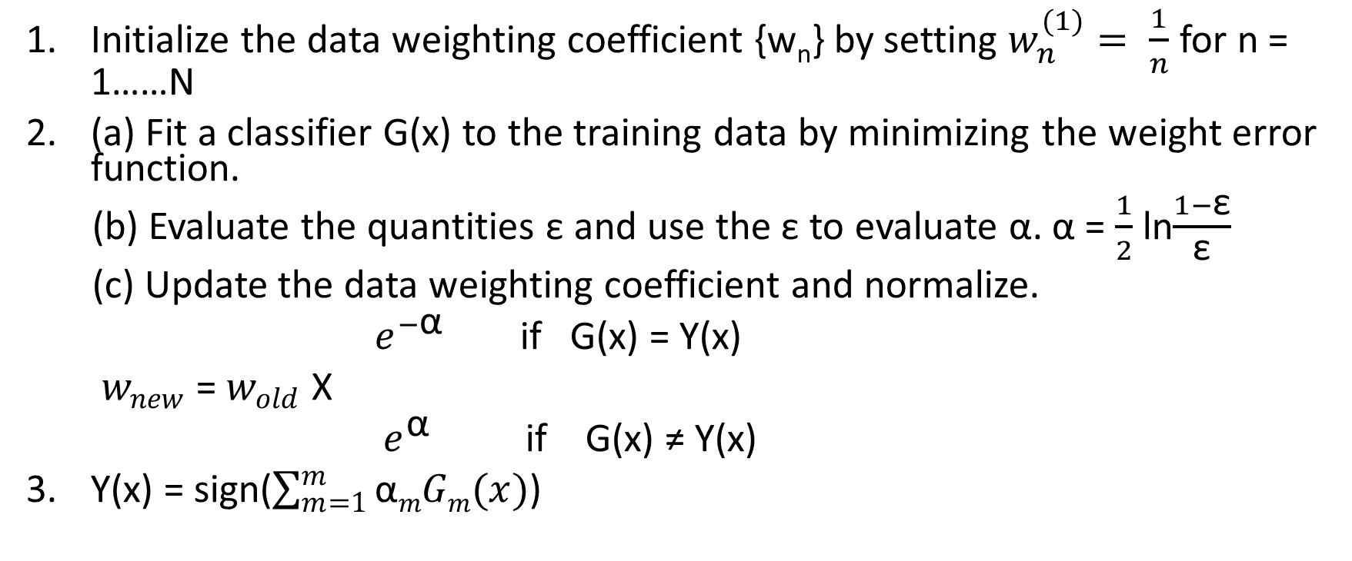
Ada Boost
Initialize the data weighting coefficient {w_{n}} by setting $w_{n}^{(1)}= \frac{1}{n}$ for n = 1……N
(a) Fit a classifier G(x) to the training data by minimizing the weight error function.
(b) Evaluate the quantities ε and use the ε to evaluate α. α = $\frac{1}{2}$ ln$\frac{1−\text{ε}}{\text{ε}}$
(c) Update the data weighting coefficient and normalize.
$e^{−\text{α}}$ if G(x) = Y(x)
$w_{new}$ = $w_{old}$ Х
$e^{\text{α}}$ if G(x) ≠ Y(x)
Y(x) = sign($\sum_{m=1}^{m}{\text{α}mGm(x)}$)

Slide 3
Example -- initialization
X: | 0 | 1 | 2 | 3 | 4 | 5 | 6 | 7 | 8 | 9
Y: | 1 | 1 | 1 | -1 | -1 | -1 | 1 | 1 | 1 | -1
Weight
X: | 0 | 1 | 2 | 3 | 4 | 5 | 6 | 7 | 8 | 9
Y: | 1 | 1 | 1 | -1 | -1 | -1 | 1 | 1 | 1 | -1
W: | 0.1 | 0.1 | 0.1 | 0.1 | 0.1 | 0.1 | 0.1 | 0.1 | 0.1 | 0.1
Weak Classifier
X: | 0 | 1 | 2 | 3 | 4 | 5 | 6 | 7 | 8 | 9
Y: | 1 | 1 | 1 | -1 | -1 | -1 | 1 | 1 | 1 | -1
W: | 0.1 | 0.1 | 0.1 | 0.1 | 0.1 | 0.1 | 0.1 | 0.1 | 0.1 | 0.1

Slide 4
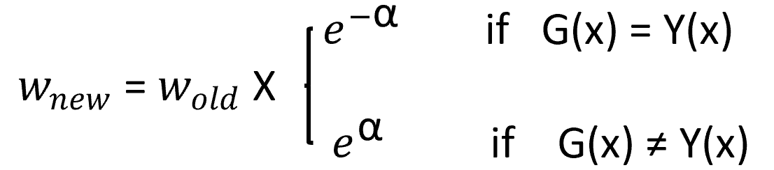
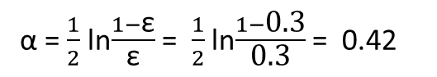
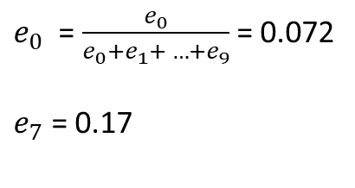
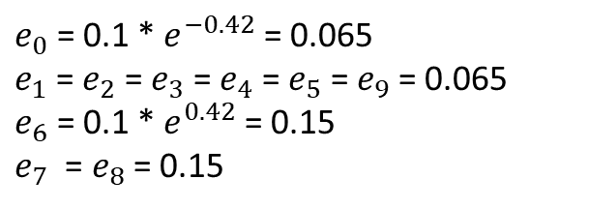
Example – iteration I
1 x ≤ 2.5
G₁ =
-1 x > 2.5
Weak Classifier
Misclassified data
X: | 0 | 1 | 2 | 3 | 4 | 5 | 6 | 7 | 8 | 9
Y: | 1 | 1 | 1 | -1 | -1 | -1 | 1 | 1 | 1 | -1
W: | 0.1 | 0.1 | 0.1 | 0.1 | 0.1 | 0.1 | 0.1 | 0.1 | 0.1 | 0.1
Calculate ε α
Update
Normalize
ε = 1*0.1 + 1*0.1 + 1*0.1 = 0.3
$e_{0}$ = $\frac{e_{0}}{e_{0}+e_{1}+ …+e_{9}}$ = 0.072
$e_{7}$ = 0.17
α = $\frac{1}{2}$ ln$\frac{1−\text{ε}}{\text{ε}}$ = $\frac{1}{2}$ ln$\frac{1−\text{0.3}}{\text{0.3}}$ = 0.42
$e_{0}$ = 0.1 * $e^{−0.42}$ = 0.065
$e_{1}$ = $e_{2}$ = $e_{3}$ = $e_{4}$ = $e_{5}$ = $e_{9}$ = 0.065
$e_{6}$ = 0.1 * $e^{0.42}$ = 0.15
$e_{7}$ = $e_{8}$ = 0.15

Slide 5
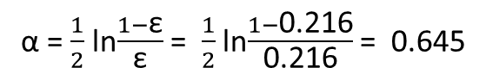
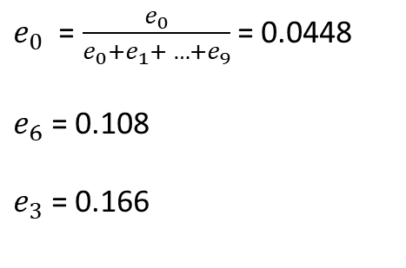
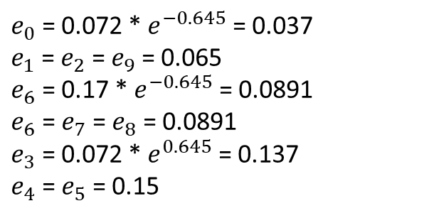
Example – iteration II
1 x ≤ 8.5
G₂ =
-1 x > 8.5
Weak Classifier
Misclassified data
X: | 0 | 1 | 2 | 3 | 4 | 5 | 6 | 7 | 8 | 9
Y: | 1 | 1 | 1 | -1 | -1 | -1 | 1 | 1 | 1 | -1
W: | 0.072 | 0.072 | 0.072 | 0.072 | 0.072 | 0.072 | 0.17 | 0.17 | 0.17 | 0.072
Weights are updated
Calculate ε α
Update
Normalize
ε = 0.073 * 3= 0.216
$e_{0}$ = $\frac{e_{0}}{e_{0}+e_{1}+ …+e_{9}}$ = 0.0448
$e_{6}$ = 0.108
$e_{3}$ = 0.166
α = $\frac{1}{2}$ ln$\frac{1−\text{ε}}{\text{ε}}$ = $\frac{1}{2}$ ln$\frac{1−\text{0.216}}{\text{0.216}}$ = 0.645
$e_{0}$ = 0.072 * $e^{−0.645}$ = 0.037
$e_{1}$ = $e_{2}$ = $e_{9}$ = 0.065
$e_{6}$ = 0.17 * $e^{−0.645}$ = 0.0891
$e_{6}$ = $e_{7}$ = $e_{8}$ = 0.0891
$e_{3}$ = 0.072 * $e^{0.645}$ = 0.137
$e_{4}$ = $e_{5}$ = 0.15

Slide 6
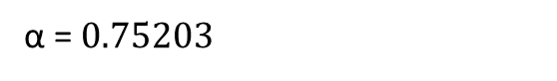
Example – iteration III
Example – iteration II
1 x ≤ 5.5
G₃ =
-1 x > 5.5
Weak Classifier
X: | 0 | 1 | 2 | 3 | 4 | 5 | 6 | 7 | 8 | 9
Y: | 1 | 1 | 1 | -1 | -1 | -1 | 1 | 1 | 1 | -1
W: | 0.0448 | 0.0448 | 0.0448 | 0.166 | 0.166 | 0.166 | 0.108 | 0.108 | 0.108 | 0.0448
Weights are updated
Calculate α
G(x) = sign (0.42G₁(x) + 0.645G₂(x) + 0.752G₃(x))
α = $0.75203$
G(x) = 0.42G₁(x) + 0.645G₂(x) + 0.752G₃(x)
1 x ≤ 2.5
-1 2.5 < x ≤ 5.5
Sign(G(X)) = 1 5.5 ≤ x < 8.5
-1 x > 5.5
0.3218 x ≤ 2.5
-0.5254 2.5 < x ≤ 5.5
G(X) = 0.9774 5.5 ≤ x < 8.5
-0.3218 x > 5.5

Slide 7
Example – Final Results
X: | 0 | 1 | 2 | 3 | 4 | 5 | 6 | 7 | 8 | 9
Y: | 1 | 1 | 1 | -1 | -1 | -1 | 1 | 1 | 1 | -1
1 x ≤ 2.5
-1 2.5 < x ≤ 5.5
Sign(G(X)) = 1 5.5 ≤ x < 8.5
-1 x > 5.5

Slide 8
Let’s look at another example!

Slide 9
Homework

Slide 10
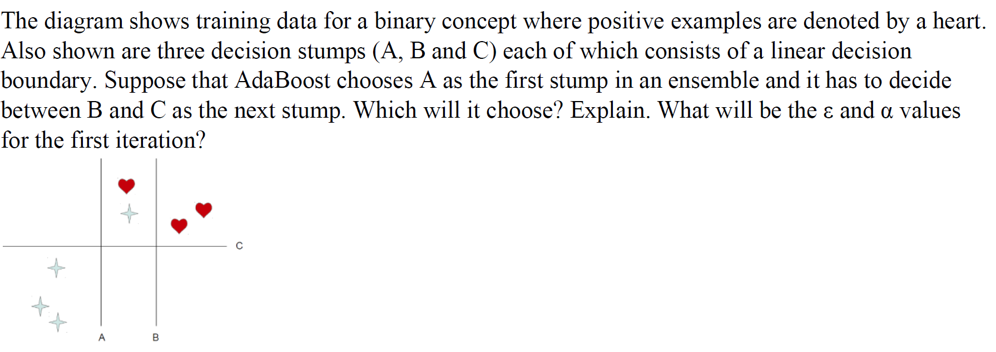
Quiz

